Slide 1

MONITORING PO RIVER WATER EXTENTS ANALYSIS
MUHAMMAD ASAD KHAN
MATRICOLA - 910038
m.khan80@campus.unimib.it

Slide 2


PROJECT GOAL:
Topic:
Monitoring the water extents of the Po River flowing south of Cremona during Spring-Summer 2023 and comparison with the same period in 2022.
Tasks:
To extract the water extents as accurately as possible by classifying the data or by using indexes applied to Sentinel-2 data.
To compute the total water surface extents statistics (histogram, mean, variance, max and min values) in the period of interest.

Slide 3



Introduction
Remote sensing is the process of detecting and monitoring the physical characteristics of an area by measuring its reflected and emitted radiation at a distance (typically from satellite or aircraft).
This report shows the methodology to calculate and compare water surface areas of the Po River south of Cremona during the Spring-Summer periods of 2022 and 2023 using Sentinel-2 satellite imagery and Google Earth Engine (GEE).

Slide 4
GOOGLE EARTH ENGINE CODE LINK:
https://code.earthengine.google.com/28b28c318af97f8d229f432151523ea8

Slide 5
Task 1: Water Surface Area Calculation.
Objective:
To develop a method that estimate the water surface area of the Po River south of Cremona using Sentinel-2 imagery.
Steps Performed:
1. Define Area of Interest (AOI): The AOI is defined as a geographic polygon encompassing the region south of Cremona along the Po River.
2. Select Sentinel-2 Images: Sentinel-2 images is filtered to select those with less than 20% cloud cover for the periods April 1 to September 30 in 2022 and 2023, to ensure the use of high graphics images.
3. NDWI Calculation: The Normalized Difference Water Index (NDWI) is used to identify water bodies. NDWI is calculated using the green (B3) and near infrared (B8) bands of Sentinel-2. The formula for NDWI is:
NDWI = (NIR - Green) / (NIR + Green)

Slide 6
4. Water Threshold Definition: A threshold value of 0.3 is used to classify pixels as water. Pixels with NDWI values greater than 0.3 is classified as water bodies.
5. Water Mask Generation: For each image, a binary water mask is generated where pixels exceeding the NDWI threshold is mark as water, and others as land.
6. Water Pixel Count: The total number of water pixels is counted for each image within the AOI using a regional reduction operation.
7. Water Area Calculation: The pixel count is multiply by the area of each Sentinel-2 pixel (10m x 10m) to convert the count to actual water surface area.
8.Total Water Area: Water area estimates for each image within the specified period is sum up to obtain the total water surface area for the Spring-Summer periods of 2022 and 2023.

Slide 7
Task 2: Comparative Analysis.
Objective:
To compare the water surface areas calculated for the Spring-Summer periods of 2022 and 2023.
Methodology:
1. Calculate Statistics: Statistical measures are computed, including mean, variance, minimum, maximum, and histogram of the water areas for the periods of interest.
2. Visualize Results: The water area time series for 2022 and 2023 is visualized using bar charts, and a combined line chart was created to facilitate comparison.

Slide 8

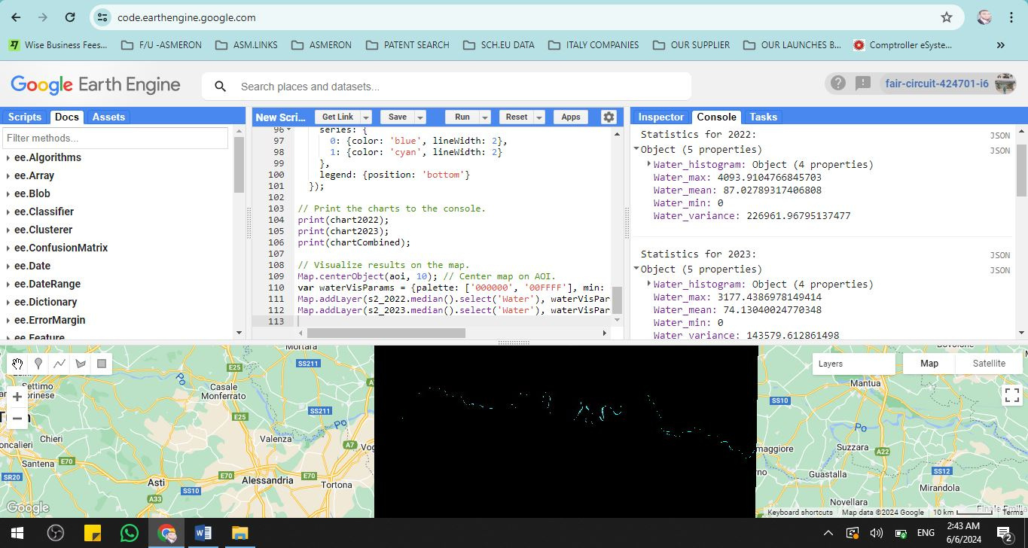
CODE OUTPUT AND MAP

Slide 9
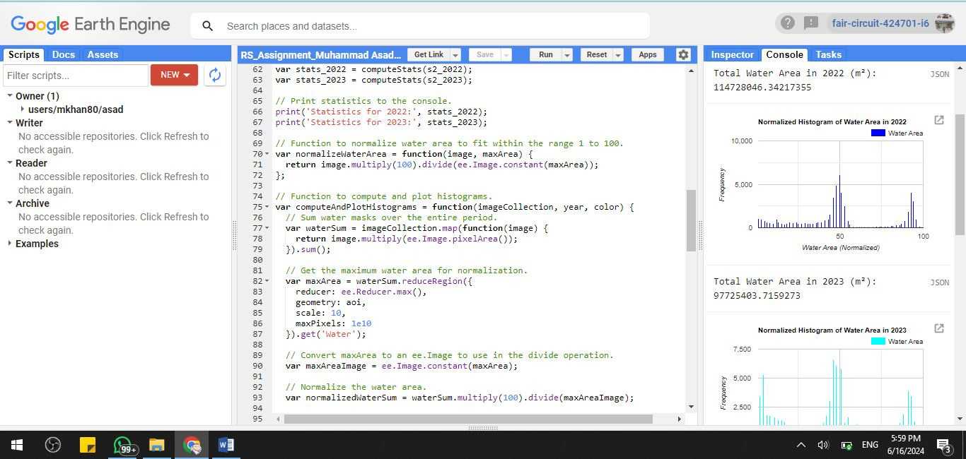
CODE OUTPUT AND MAP

Slide 10
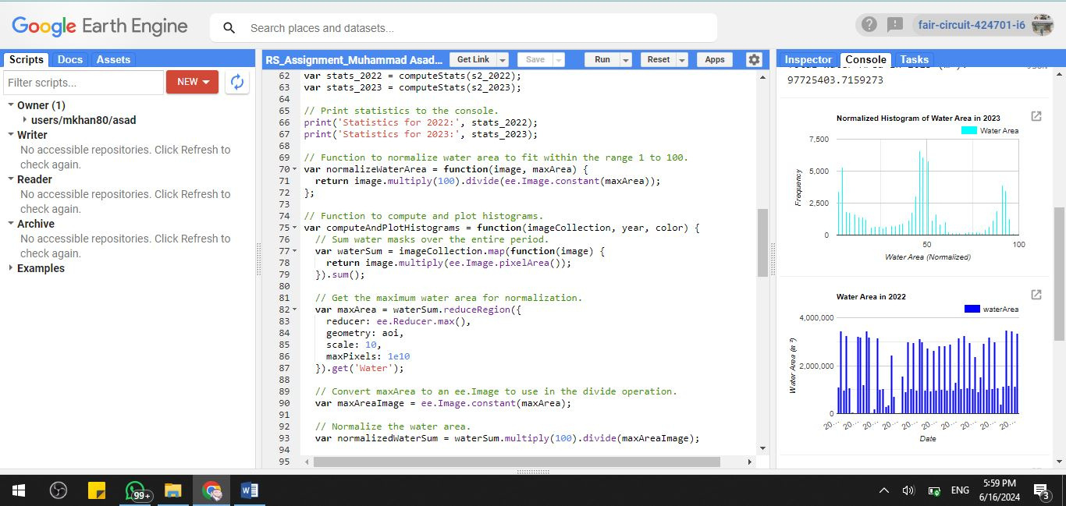
CODE OUTPUT AND MAP

Slide 11
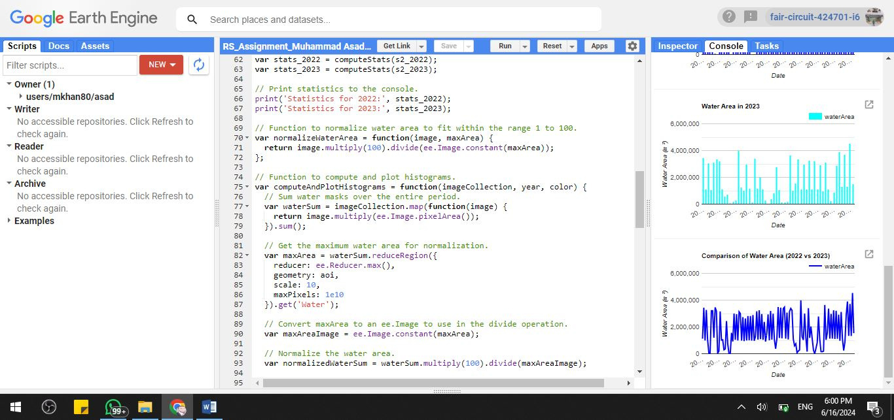
CODE OUTPUT AND MAP

Slide 12

STATISTICAL ANALYSIS
Statistics for 2022:
Maximum Water Area: 4093 . 91 m²
Mean Water Area: 87 . 03 m²
Minimum Water Area: 0 m²
Variance in Water Area: 226961 . 97 m²
Total Water Area in 2022: 114728046 . 34 m²

Slide 13
STATISTICAL ANALYSIS
Statistics for 2023:
Maximum Water Area: 3177 . 44 m²
Mean Water Area: 74 . 13 m²
Minimum Water Area: 0 m²
Variance in Water Area: 143579 . 61 m²
Total Water Area in 2023: 97725403 . 71 m²

Slide 14
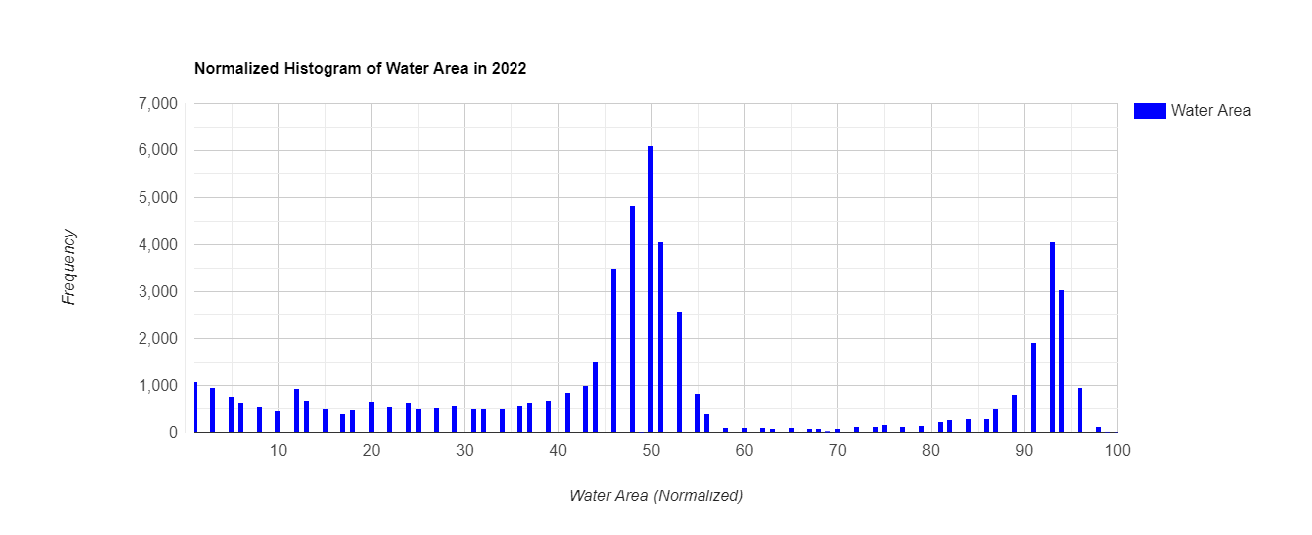
HISTOGRAMS
YEAR 2022:

Slide 15
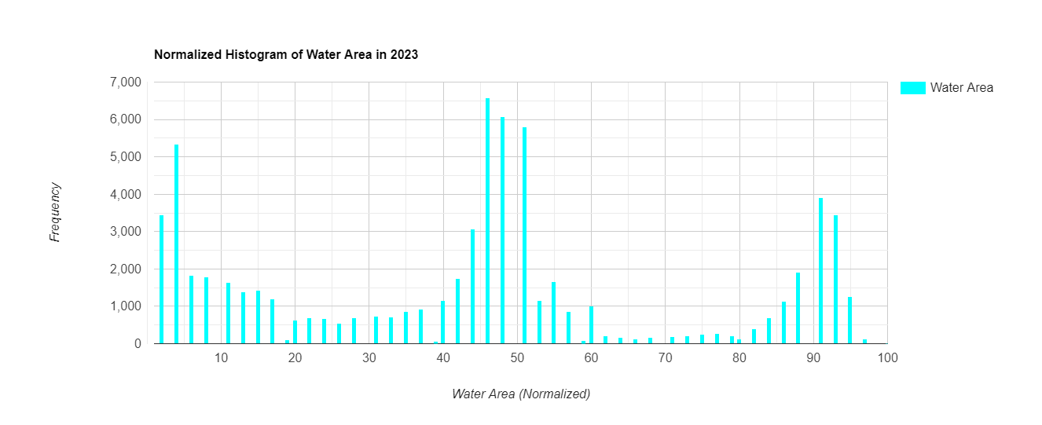
HISTOGRAMS
YEAR 2023:

Slide 16
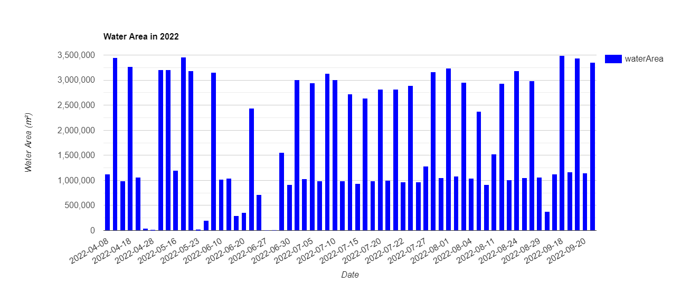
RESULTS AND COMPARISON
Overview of Water Extents in 2022
The 2022 saw a significant variation in the water level of the Po River south of Cremona. In MAY the level of water is further increased. However, in JULY we have seen drop water levels.

Slide 17
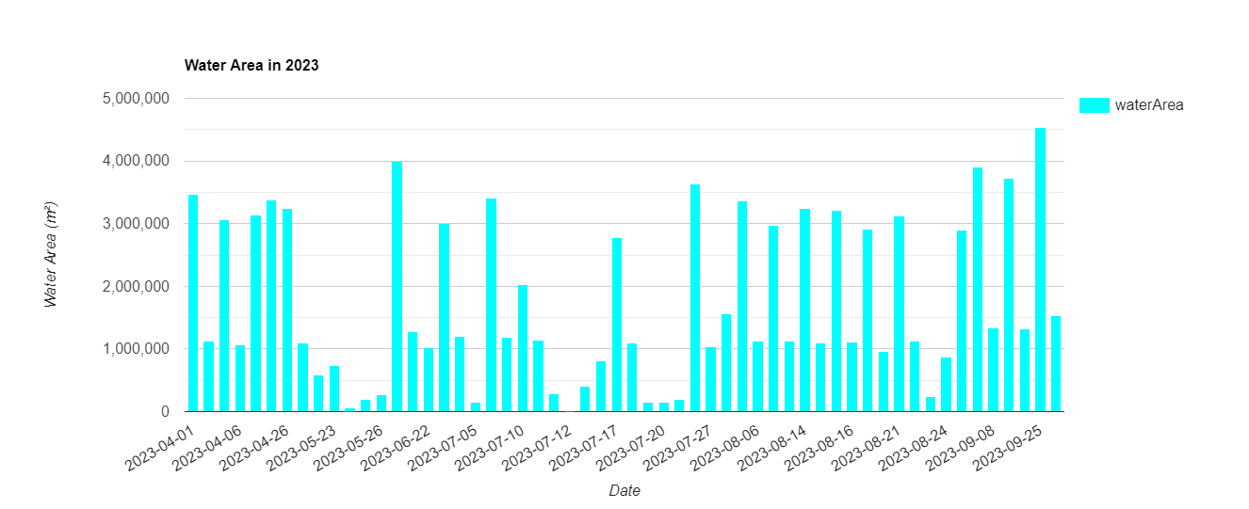
RESULTS AND COMPARISON
Overview of Water Extents in 2023
The analysis of the Po River's water extents in 2023 has differences compared to 2022.
In MAY it has higher water levels due rainfall and/or snowmelt. These variations show how climate influences affect rivers and emphasize the value of continuous monitoring.

Slide 18
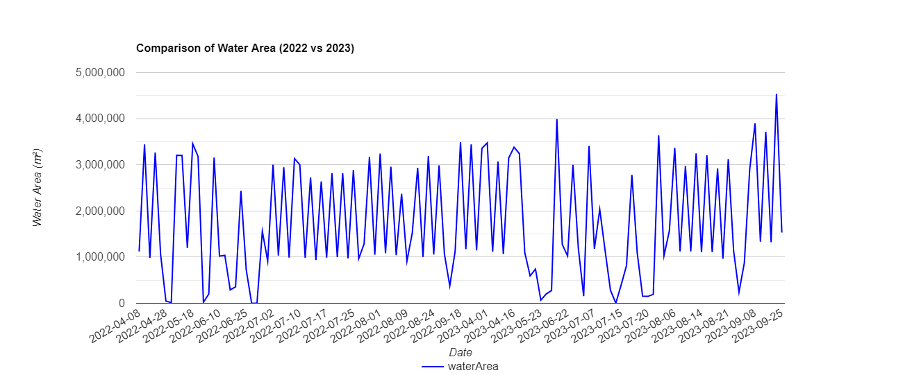
RESULTS AND COMPARISON
2022 vs 2023 Water Extents
The Po River's water extents in 2022 and 2023 are contrasted in this graph. The differences in total water surface levels, as well as changes in maximum and minimum values, are highlighted. These metrics help in understanding the trends observed in these two years.

Slide 19

CONCLUSION
This research created an effective way to evaluate water resources using Sentinel-2 photos. A comparison between 2022 and 2023 showed that the Po River's water availability may fall, showing the importance of careful water management and observation.

